Slide 1
Simplifying Breastfeeding

Slide 2
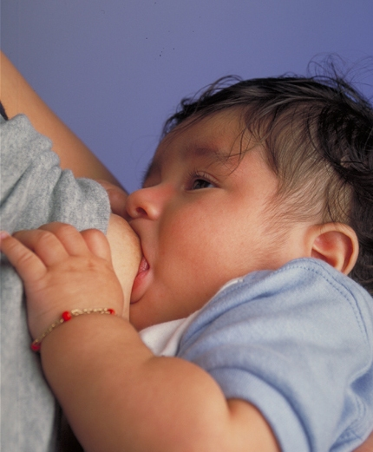
Outline
Why breastfeed?
Intro to breasts, breastmilk and breastfeeding
Skin to skin
Breastfeeding positions
Latching on
What to expect in the early days
Breastfeeding problems
Supplementing

Slide 3
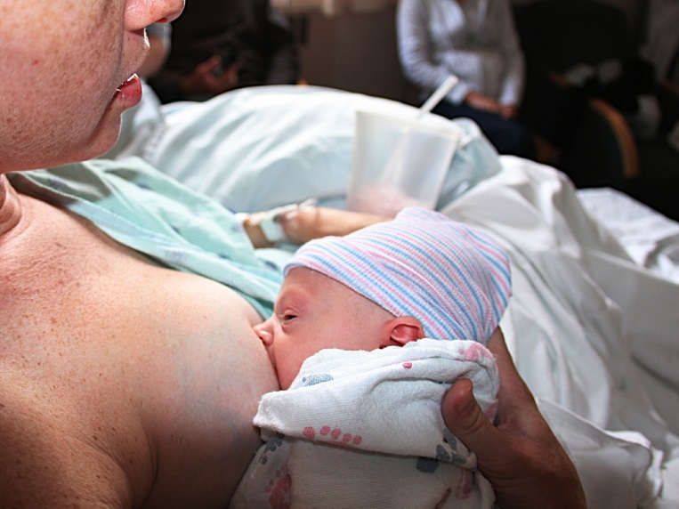
Why Breastfeed?
The World Health Organization and Canadian Pediatric Society recommend babies receive only breastmilk for the first 6 months of their lives
Babies should continue to
receive breastmilk after 6
months as they slowly start
to take other foods as well

Slide 4
Why Breastfeed?
Benefits for baby
Easy to digest
Ideal nutritional choice
Grows with baby
Reduces risks of ear, chest and stomach infections
Reduces risks of asthma and allergies
Reduces risks of obesity and diabetes
Introduction to family foods
More quiet time with mom
Notes:
Coats babe’s gut and protects them from infection
Breastmilk changes from month-to-month, day-to-day, even feed-to-feed depending on baby’s needs
Flavours of foods mom eats can go through the breastmilk, can help introduce babe to family foods and flavours early on

Slide 5
Why Breastfeed?
Benefits for mom
Lowers risk of breast and ovarian cancer
Lowers risk of bleeding after birth
Helps you lose pregnancy weight faster
Can delay your period
Saves as much as $2 000
No need to sterilize bottles or nipples or warm formula
Notes:
Can use this link to calculate the cost of formula over 1 year. Similac costs $25.96 per can at Walmart in Calgary and gives 150 ounces
https://kellymom.com/pregnancy/bf-prep/bfcostbenefits/

Slide 6
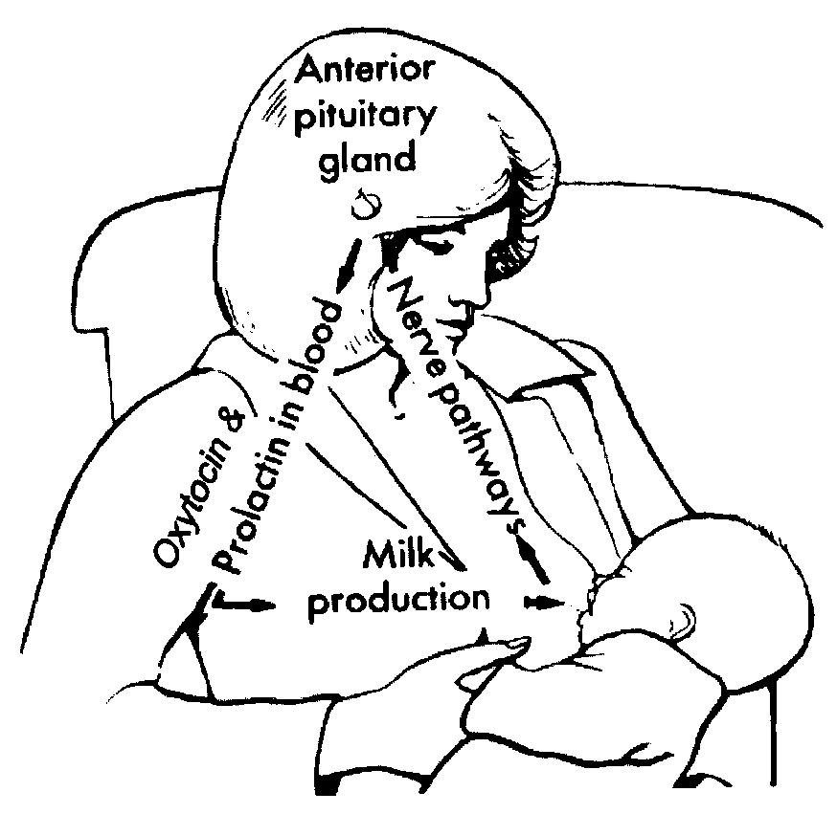
Intro to Breasts and Breastfeeding
Areola
Nipple
Milk
Notes:
Areola- Discuss darker area, can be different sizes, generally becomes larger and darker in pregnancy
Nipple – nipple rings? Odd shapes? Likely not an issue for breastfeeding, may want to have assessed in pregnancy
Review changes in size of breasts during pregnancy – Discuss with physician if no change or discomfort occurs
small breasts vs. large breasts does not determine milk supply. Large breasts have more fat, not necessarily more lobes.
Review oxytocin and prolactin briefly
Prolactin triggers the alveoli to produce milk
Oxytocin triggers the “let down” and ejection of milk into the ducts
When breasts are full and are not emptied, small whey protein presence decreases milk production
Effective, frequent emptying of the breasts is essential to milk production

Slide 7
Early days of breastfeeding
In the first 6 months, when do you think is the most likely time for a woman to choose to stop breastfeeding?
Why do you think that is?
What can you
do to avoid this?
Notes:
A: within the first 2 weeks
A: discuss steep learning curve, difficulties after delivery, positioning and latch, exhaustion etc.
A: This class! Give yourself some slack, remember it can be challenging but it will get easier, set yourself up for success, don’t compare breastfeeding to formula feeding.

Slide 8
Stages of Breastmilk
Colostrum
Present from 5th month of pregnancy
First milk babies get
High in antibodies
Coats baby’s gut to protect from bacteria and viruses
Very easy to digest
Small volumes
Mature Milk
Appears around day 3 postpartum
Has the same protective factors as colostrum
More water and fat
Offers all the calories baby needs
Grows with baby’s needs
Notes:
Can use orange juice concentrate for example. Colostrum is like what you find in the can- low volume but has all the good stuff, mature milk just adds water (and fat)

Slide 9
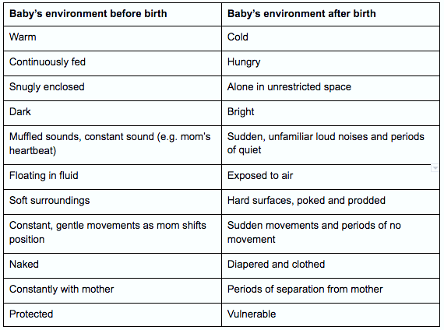
The Magic of Skin to Skin
Notes:
Discuss the difference between baby’s environment before and after birth. Ask mom’s to consider how this would feel

Slide 10
The Magic of Skin to Skin
Notes:
Skin to skin – As close to inside the womb as possible. Baby can hear mom’s heartbeat and breathing, easy for mom to speak softly to them, feel mom’s warmth, things tend to slow down – no interventions at this time, etc.

Slide 11
Skin to Skin
The WHO and Canadian Pediatric Society recommend babe be placed skin to skin with mom for at least 1 hour after delivery
This helps mom expel the placenta
Gives the perfect opportunity for the first breastfeed
If it’s not possible, baby can be
skin to skin with dad
The benefits continue through
the first weeks after birth
Notes:
Babies who go skin to skin will:
be more content and cry less.
have a more steady body temperature.
have a more regular heart rate and breathing rate.
have higher blood sugars.
better tolerate painful procedures, such as blood tests, when snuggled skin to skin.
find it easier to latch to the breast.
Skin to skin benefits for moms
Moms find it:
easier to know when baby is hungry.
easier to latch baby at the breast.
easier way to wake baby.
easier to soothe a fussy baby.
helps her body to make more milk (by increasing the production of prolactin).
enhances bonding with baby.

Slide 12
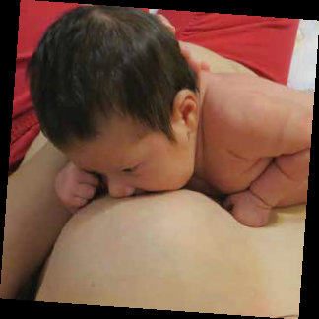
The First Feed
Babies are in quiet-alert phase for first few hours after birth. This is the perfect time to get breastfeeding off to a great start

Slide 13
https://www.youtube.com/watch?v=uMcgJR8ESRc&rel=0 (10 mins)

Slide 14
The First Feed
Some babies may not latch immediately after delivery.
This is OK!
Some moms and babies need a bit more time, due to a difficult delivery, medications during labour, long labour etc.
Keep offering the breast, and keep baby skin to skin, it will come!

Slide 15
Breastfeeding Positions- The Basics
Mom is Comfortable
Use pillows to support back and arms if needed
Make sure there is no pressure on C-section incision or swollen vagina
Baby is Supported
Baby’s head, shoulders and hips should be supported. This can be by your arm or hand, a pillow, your body, the bed etc.
Baby’s ear, shoulder and hips should all be in a line
Tummy-to-Mummy
No matter the positions baby’s belly should be pressed towards mom’s body
Baby in line with nipple
Sniffing Position
Baby’s head tilts back with nose in line with nipple and neck extended
Notes:
Remember these 4 points apply for all positions.

Slide 16
Laid Back Nursing
Lets baby do a lot of the work
Allows mom to be relaxed and comfortable
No sore arms or back from supporting baby’s weight
No pressure to C-section incision or sore vagina
Gravity helps with deep latch
Notes:
Address previous 4 points
Mom is Comfortable – use pillows to prop self up
Baby is Supported – Babe rests on mom, some support from mom’s hands and arms as needed
Tummy-to-Mummy – Naturally occurs in this position
Sniffing Position – When babe latches himself he will automatically wind up in this position to latch
find a comfortable place where you can lean back and relax.
Lean back far enough so that gravity will help to keep baby close to your body.
Use pillows to support your head and back as needed.
Baby’s entire body should rest against your body with his cheek resting near your bare breast.
Use your arms to support your baby in whatever way feels most comfortable.
Your baby will lift his head and use his arms and legs to reposition himself until he finds the nipple.
Some babies will need more help than others; use gentle guidance to nudge your baby towards the breast if needed. Remember, it takes practice to make any position work for you and your baby.
In the first few days of life, this position works best when both mom and baby are skin-to-skin (no shirt for mom, baby dressed in a diaper only). This helps to encourage baby’s natural feeding instincts.

Slide 17
https://www.youtube.com/watch?v=XZfGzJBBwME&rel=0&start=77 (3:35)

Slide 18
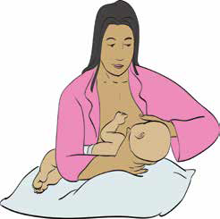
Cross-Cradle Hold
Mom sits up with support for her back and arms
Baby’s back rests along mom’s forearm and his head is supported by mom’s thumb and index finger behind the ears
Don’t push on back of baby’s head
Allows mom to support baby but gives him the ability to move and bob his head
Notes:
Mom is Comfortable – use pillows to prop self up, rest arms
Baby is Supported – Babe supported by mom’s lap or pillows. Also by mom’s arm behind him
Tummy-to-Mummy – Make sure this occurs so babe’s neck isn’t twisted, makes swallowing harder
Sniffing Position – Line up nipple to nose to help this happen

Slide 19
https://www.youtube.com/watch?v=MRz8Bozv4nw&rel=0 (2:29)

Slide 20
Football Hold
Can be a comfortable position for women who had a C-section or have larger breasts or smaller babies
Mom sits up comfortably with pillows next to her to support arm and baby
Baby lies next to mom’s body underneath her arms with his legs tucked in behind her
Baby can come up and over the nipple
or be turned to the side
Notes:
Baby may start to kick the back of the chair in this position. To avoid this place a pillow behind your back so baby can’t reach the back of the chair or tuck his legs in before latching.
Mom is Comfortable – use pillows to prop self up and for arms
Baby is Supported – on pillow or armrest, mom’s arm also provides support
Tummy-to-Mummy – Turn babe’s tummy in, not pointed to the ceiling
Sniffing Position – Line nipple with nose to help with this

Slide 21
https://www.youtube.com/watch?v=2NMQg8nDOms&rel=0&start=33 (1:37)

Slide 22
Side-Lying Position
Allows mom to lie comfortably in bed on her side
Use a pillow or cushion to support mom’s back
Baby lies next to mom on the bed
Make sure baby’s bum is tucked in close and her body is turned to face mom
Notes:
Mom is Comfortable – use pillow for head and neck
Baby is Supported – babe rests on bed, can use pillow or rolled towel for support behind back
Tummy-to-Mummy – roll entire body towards mom
Sniffing Position – Line up nipple to nose to help with this

Slide 23
https://www.youtube.com/watch?v=XZfGzJBBwME&rel=0&start=33 (3:35)

Slide 24
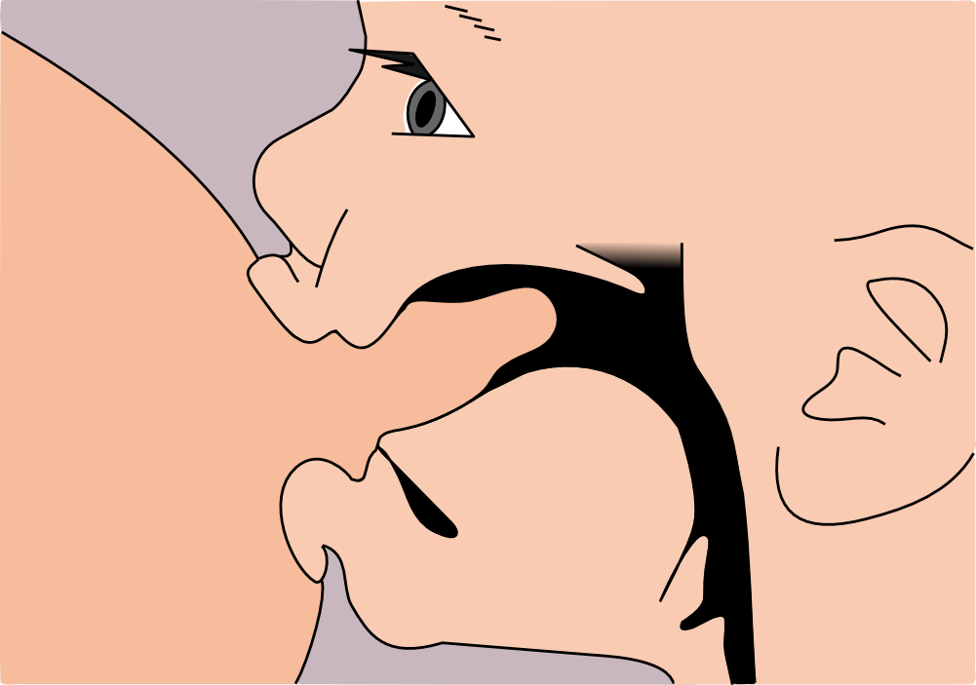
The Latch
Why is this important?
Mom’s comfort- With a deep latch, mom’s nipple won’t be pinched and mom can avoid cracks or nipple pain
The amount of milk – The deeper baby is latched on the more milk he will get
Notes:
If the latch isn’t deep enough the baby compresses and pinches the nipple with each suck, while if the nipple is way back into the back of the mouth they compress more milk ducts and no longer compress just the nipple.

Slide 25
https://www.youtube.com/watch?v=CamB7TCd5Z8&rel=0 (11 secs)

Slide 26
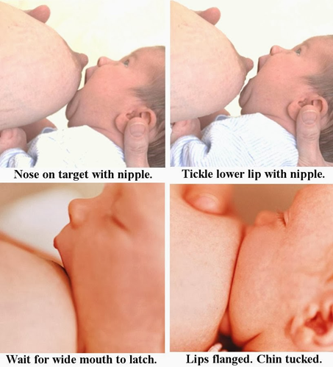
How to Get a Good Latch?
Nipple not centered in baby’s mouth. Bottom lip should be further away from the nipple than the top lip. “asymmetrical latch”
Have mom’s nipple opposite baby’s nose before latching
Baby should have a big wide open mouth when latching
Tickling baby’s top lip with your nipple can help with this
Bring baby straight onto the breast
Don’t bring the breast to baby, bring baby to the breast
If baby is crying calm them before latching
Notes:
If your baby needs extra help with latching, try this trick:
Gently shape or “sandwich” the breast, using your thumb and fingers. (Imagine eating a large sandwich; it is easier to fit into your mouth if it is flattened first.) Please note: you sandwich the breast to help it fit into baby’s mouth. The flattened part of the “sandwich” should be parallel to baby’s lips. Make sure hands are positioned far back from the nipple so they don’t get in the way.
Encourage baby to open wide by tickling his upper lip with your nipple. In response, your baby will lift his chin and gape widely. Aim the nipple towards the roof of baby’s mouth. Baby’s chin should touch the breast first.
If your baby is crying or upset, calm him and then try again.
Try to get baby’s bottom lip as far as possible from the base of the nipple. The lips should be flanged outwards when latched.

Slide 27
What Does a Good Latch Look Like?
Nose
up and free of breast
Lips
at very wide angle and flanged
More areola visible above than below mouth
Chin
Tucked into breast
Jaw
moves up and down rhythmically with pauses for swallows
Baby deep onto the breast, not just sucking on the nipple
Baby appears relaxed
Notes:
Nose – Babies won’t remain on the breast if they can’t breathe. Some women with larger breasts feel they need to pull their breast tissue away from baby’s nose. If they are latched properly this shouldn’t be necessary and if not, baby will come off the breast themselves.
Lips- duck lips. If not latched deep enough lips will look tight and pursed as if sucking on a straw
Remember women have different sized areolas so don’t focus too much on how much you can see, though you can compare it to past feeds.
Jaw- Suck should involve the whole jaw, not just the lips. Pause happen when baby’s mouth is the widest, before it starts to close. The longer the pause the more milk. If there is no pause, could indicate they aren’t getting milk.
May hear swallows. Easier to hear later on.
After a feed the nipple should be round and elongated. If it has a white line across it or it is slanted like a tube of new lipstick there has been too much pressure on the nipple

Slide 28
What Does a Good Latch Feel Like?
Some tenderness can be normal in early days
Initial tenderness should ease after first few sucks
Tugging sensation is normal
Pinching is not
***LATCH SHOULD NOT BE PAINFUL***
If your toes are curling, it is not a good latch. Try again
If the latch and baby’s position look good but it is still painful, there may be something else going on. See a physician, community health nurse or lactation consultant immediately

Slide 29
28 Hour old Latching well
https://www.youtube.com/watch?v=uZYZpWJKWUw&list=PLis4R2b4QuLylOogX9vMPl7zIRGuaUTYV (1:07)

Slide 30
Nibbling vs. Sucking
https://www.youtube.com/watch?v=a0dYIoovLXY&list=PLis4R2b4QuLylOogX9vMPl7zIRGuaUTYV (27 sec)

Slide 31
Nibbling vs. Sucking
https://www.youtube.com/watch?v=a0dYIoovLXY&list=PLis4R2b4QuLylOogX9vMPl7zIRGuaUTYV (2:00)

Slide 32
Time to Feed?
Things to remember
Baby is dependent on you for all feeds.
She is unable to go to the fridge and grab a quick drink of water.
Baby may just be a little thirsty and may not need a full feed
Baby doubles her birthweight in 6 months
Frequent feeds are normal
Babies should be feeding at least 8-12 feeds in a day.
That’s at least every 2-3 hours
But watch your baby not the clock
Notes:
Fill out questionnaire – How often do you eat? Directions- Make a note any time you ate or drank anything (includes a quick sip of water to a full meal and anything in between)
Discuss. Adults are individuals, some will eat a few big meals a day and that is close to all. Some will graze and sip water every hour while they are awake. Babies are the same, no two feeding patterns are the same

Slide 33
Watch Your Baby Not the Clock
Signs of hunger
Becoming more active eg. stretching
Sucking
Rooting
Arms and legs tight
Crying – This is a late sign of hunger
Signs of fullness
Baby is relaxed
Arms and hands loose
Does not root when checked with finger
***Follow your baby’s cues***
Notes:
Try to feed baby when you notice early hunger cues. Babies are much easier to latch and feed when they are calmer. Crying is a late hunger cue, this means you have missed their early cues and they are REALLY HUNGRY. It is much harder, especially in the early days to feed a very hungry baby.

Slide 34
https://www.youtube.com/watch?v=ABAXgubx58Q (2:30)

Slide 35
What to Expect in the First Few Days?
Remember quiet alert phase immediately after birth
This usually lasts a few hours or so
Perfect time for the first feed
Following 24 hours babies will go into long restful sleep
Babies will need reminders to eat during this time
Try to wake babe every 2-3 hours to feed
May not feed well. As long as there are no other health concerns with baby, this is ok
The important thing is to offer the breast
After 24 hours
Baby is more awake and very interested in feeding
Very frequent feeds – this is normal, you aren’t doing anything wrong
Breasts are still soft – colostrum still available in small amounts, perfect food for baby at this time
Tiring time for mom and dad
Notes:
Frequent feeding in the second 24 hours is a signal to mom’s breasts to start increasing milk supply.
We suggest not using a pacifier at this time. If baby is sucking on the pacifier, you may miss feeding cues, this takes away those signals from baby sucking to begin making more milk and can slow this process down
Tiring time – May want to consider not having visitors at this time. Good idea to discuss this before baby arrives and have a plan in place regarding friends and family at this time

Slide 36
Partner Tip
Babies second day is an exhausting time for you and your partner and you may feel helpless when baby is feeding so often. Some things you can do to help:
Diaper changes
get baby ready to feed
Burping
gives you a lovely time to bond with baby
Be a cheerleader
Tell her how good a job your partner is doing
Don’t repeatedly offer to give baby a bottle
Notes:
Diaper changes- when they begin to stir, change diaper, strip them down etc. allows your partner to use the washroom and get comfortable before feeding
Burping – gives you a lovely time to bond with baby, they should be full and content. You can hold baby skin to skin and give them a nice snuggle as they drift off to sleep afterward
Cheerleader- – Moms can be very tired and sore after delivery. She is learning a new skill and it can be difficult. Tell her how good a job she is doing, use your knowledge from this class to help with positioning and latching. Don’t repeatedly offer to give baby a bottle. Their behavior is normal and mom can start to feel really discouraged at this time. You offering to give bottles can derail breastfeeding, even if you are just trying to help.

Slide 37
3rd Day of Breastfeeding and Beyond
Day 3
Breasts are starting to feel heavier
When hand expressing, milk may change from yellow colostrum to white mature milk
May hear more swallows
Frequent feeds remain normal
Night time feeds are common
Day 4-5
Breasts may feel overly full and tender
If the areola is overly firm, use hand expression to soften
10 days – 2 weeks
Breasts will adjust to baby’s needs and feel softer
You may worry you have lost your milk supply. This is not the case, this is normal!
Notes:
Breasts feeling fuller – Happens earlier in second and third time moms. May be later if mom had a postpartum bleed, medications in labour, if mom is separated from baby or baby does not get to the breast frequently in first days.
Will discuss hand expression in a bit – Use beach ball example – trying to hold a fully inflated beach ball with one hand can be difficult, if ball is deflated a bit, it’s much easier to hold

Slide 38
What about a bottle?
It can be very tempting in the early days to want to offer a bottle of formula. Unless medically necessary, we discourage this for a number of reasons:
Interrupts the good colostrum is doing
Colostrum coats the baby’s gut to protect her from infection. Any formula breaks down this coating
Frequent feeding has a purpose
Signals mom’s body to start making more milk
Less frequent feeding can slow this process and cause a delay in mom’s milk production
Can be difficult to get baby interested in the breast again
The flow of milk from the bottle is faster than the breast. Some babies become hooked on this and may have difficulty becoming interested in the breast again
Notes:
Reinforce that frequent feeds are normal, but not permanent.

Slide 39
Is Baby Getting Enough?
Less than 5% of women aren’t able to produce enough milk for their baby, so the chances are really low that this is a problem for you
But how can I tell they are getting enough?
Good Ways
Weight
Wet diapers
Dirty diapers
Baby’s behavior
Bad Ways
Time
Pumping
Breast fullness
Bottle after feeds
Notes:
Weight -Discuss loss of weight initially is normal, first 3-4 days. 20-30g gain a day after this. Back to birthweight at 2 weeks. Community health nurses will assess this at visit
Will address pees and poops with next slide
Behaviour – Baby should be relaxed and content after feeds once milk volume has increased. Best way to tell is by burping baby. If baby is “milk drunk” like a limp noodle in your hands, this means they are full. If baby continues to suck their hands and root around and is very active, this is a sign they are still hungry and you should offer the breast again.
Cluster feeding – Often in the evening but can happen at any time. This is normal, follow baby’s cues not the clock
Time – Strength of baby’s suck, mom’s let down and milk flow, how effective latch is, how relaxed mom is, capacity of breasts can all affect how long a feed takes and how frequent they need to be. Some babies can have a full feed in 5 minutes and some can take up to an hour in the early days. Some babies can go 3 hours between feeds, some need to feed every hour, this can also change depending on the time of day. Over 5 days old and baby is still feeding all day and night, there may be something else going on, it might be time to contact a lactation consultant. But otherwise watch your baby, not the clock!!!
Pumping- Will discuss pumping more later, but babies are SOO much better at removing milk than your pump. Babies use both suction and compress while pumps only use suction, also remember oxytocin the “love hormone”, no one loves their pump as much as they love their baby, baby will always get more milk than a pump.
Fullness – as addressed earlier, breasts make milk while baby is feeding, fullness goes away by 10-14 days
Bottle – some parents believe that if baby takes a bottle after a feed it means they are still hungry. This is not the case. Almost all babies will suck on a bottle even if they are completely stuffed and take ½ an ounce or more. Depending on the bottle it is a swallow or drown situation so they will drink because they have to.

Slide 40
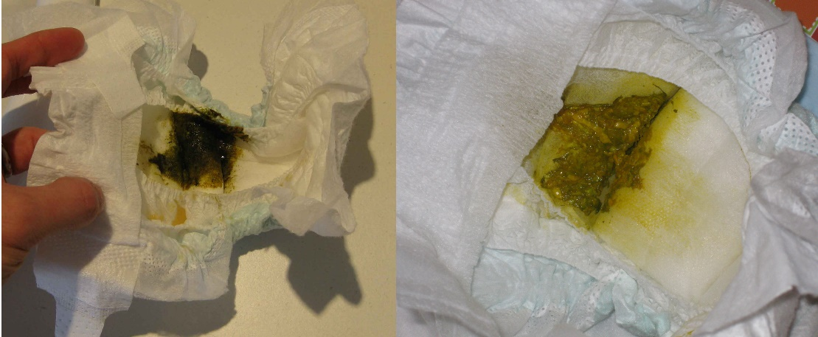
Expected Diapers
Minimum number of diapers to expect in 24 hours
Age in days | Wet diapers | Dirty diapers
1 | 1 | 1
2 | 2 | 1
3 | 3 | 2
4 | 4 | 2
5 | 5 | 2-3
5+ | 5-6 | 2-3
Notes:
Discuss meconium. Because breastmilk is so easily digested, some babies will not poop daily once meconium has cleared. As long as everything else is ok- weight, jaundice, baby’s behavior etc. this can be considered normal. As baby grows normal # of poops will change. 5+ poops a day can be normal, 1 Poop every week can be normal, as long as weight and behavior are good, no concerns.
Pees will be light in the first few days- Best way to tell is the strip on the diaper. By day 5 pees should be heavy, don’t need strip to tell that there is a void.

Slide 41
Breastfeeding Problems
92% of women reported at least 1 breastfeeding problem by day 3
Don’t panic, but know you’re not alone if you are struggling
Most problems have simple fixes
If you’re having a problem go back to the basics – Skin to skin, proper positioning, good latch
Most common problems are sore nipples and concerns baby isn’t getting enough
Find support from a lactation consultant or community health nurse to help solve problems

Slide 42
Sore Nipples
Tender vs. sore?
Tender in the first days with the first few sucks is normal, should improve
True pain is not – when your toes curl or you feel the need to pull away
Back to the basics
Have a nurse or lactation consultant assess the latch
Remember what we discussed earlier, signs of a good latch
Nipple creams?
Expressed breastmilk on the nipples is as effective or more effective than creams
For most women sore nipples resolve to satisfactory levels by 7-10 days

Slide 43
Baby Won’t Latch
Many different reasons baby won’t latch
Most can be resolved by going back to the basics
Spend as much time as possible with baby skin to skin (Ask your partner, family or friends to help with care of older children, household chores etc.)
Watch for early signs of hunger and offer the breast on demand
Avoid bottles whenever possible
See a community health nurse or lactation consultant for extra help
Notes:
Early introduction of the bottle for whatever reason, trauma at birth, excessively sleepy etc.

Slide 44
Medical Reasons to Supplement
Sometimes babies may need to be supplemented for a medical reason such as;
Low birth weight or premature
Low blood sugar
Some metabolic disorders (rare)
Dehydration
Losing too much weight (>7-10%)
Jaundice
If baby does need to be supplemented the first choice is your own breastmilk, second is donor breastmilk, third is formula
Notes:
Your own breastmilk – in the early days babies are only meant to receive colostrum so shouldn’t need supplementation in huge amounts, hand expression is the best way to collect colostrum. Later on pumping or hand expression can both work
Donated breastmilk- in Alberta there is a limited supply, it is only available for the sickest babies and by prescription only
Formula- we don’t recommend unnecessary formula supplementation, your breastmilk is all baby should need, but if there are any of these cases then the most important thing is that baby is being fed.
Usually supplementing is temporary – work with a community health nurse or lactation consult to return to full breastfeeding once problems have resolved

Slide 45
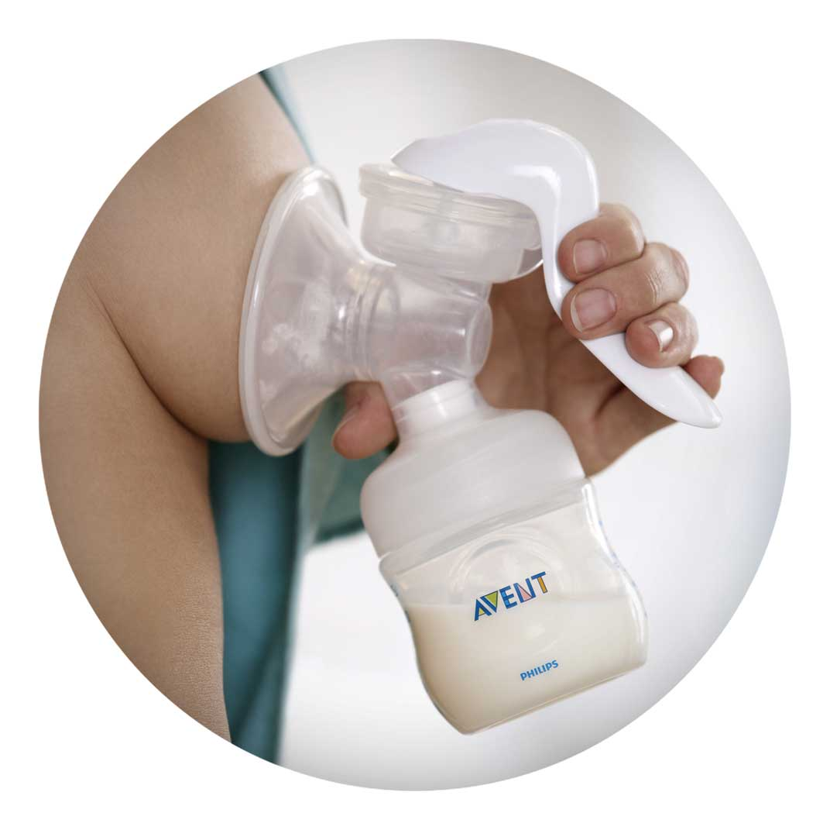
Supplementing with your own breastmilk
Breast pumps
Hand expression

Slide 46
Breast Pumps
All women are eligible for one manual breast pump per birth through NIHB
Prescription needed from you doctor
Can take a few days to go through NIHB, may not be available immediately
Pumping can be a great way to store breastmilk but they can be annoying to cart around and they need to be cleaned after each use
A lot of women believe they are necessary, they are not. You can successfully breastfeed without a pump

Slide 47
Breast Pumps - Tips
It’s recommended not to introduce the pump too early. Try to wait a few weeks at least, once breastfeeding is going well
If baby needs supplementing you can use hand expression to collect breastmilk
This gives baby time to get used to feeding at the breast, without getting used to the bottle
Remember, your breasts need regular stimulation and milk removal to continue to make milk.
Avoid giving multiple feeds of pumped milk in a row without breastfeeding or pumping as well

Slide 48
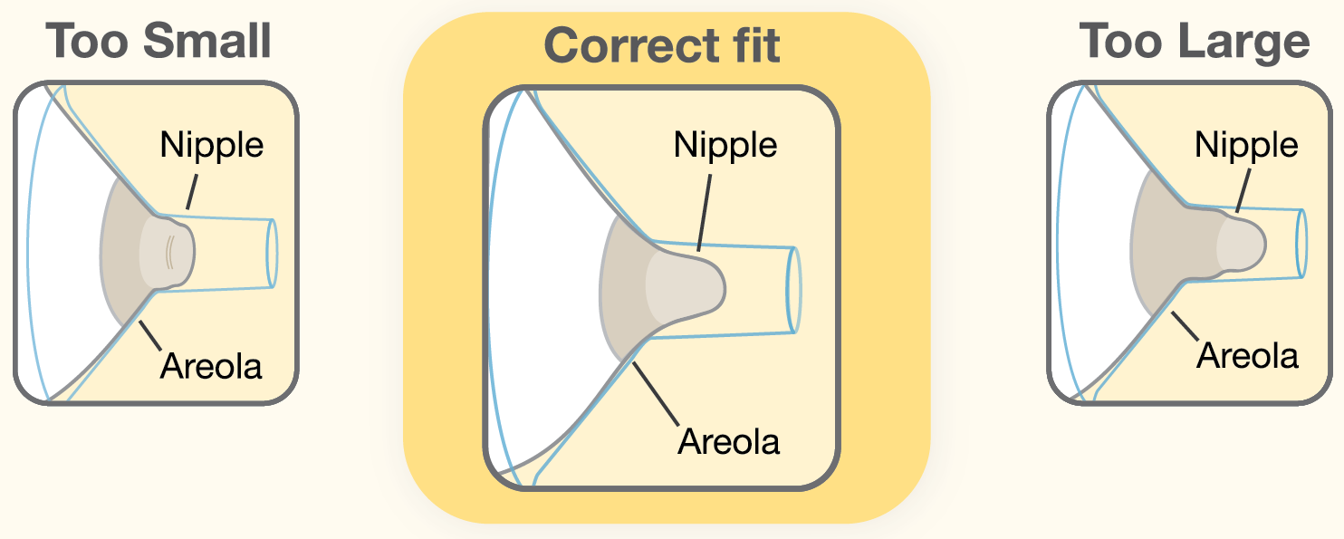
Breast Pumps - Tips
There are many different kinds of breast pumps; manual, electric and hospital grade which can be rented from some pharmacies
Remember no kind of pump is as good at removing milk from your breast as baby is
Make sure the pump flange fits. Most pumps only come with one size, breasts and nipples are not one size fits all

Slide 49
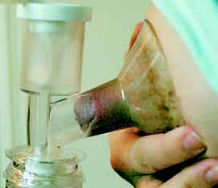
How is the Fit?
Notes:
Too small

Slide 50
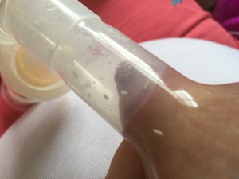
How is the Fit?
Notes:
Too big

Slide 51
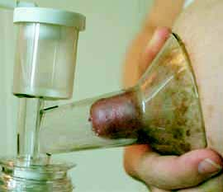
How is the Fit?
Notes:
Good fit

Slide 52
Hand Expression
Why Hand Express?
Can be very useful in early latching attempts
If baby is a little sleepy, you can express a little bit of colostrum onto you nipple. Baby will smell this and it can make them more interested in feeding
Overly full or engorged breasts
Hand expression softens the breast and this allows baby to latch more easily and fully empty the breast for you
Separation from baby
Can be as effective as pumping, especially in the early days
Makes pumping more effective if used in combination
If there is a power outage or your pump is unavailable

Slide 53
How to Hand Express
Start by relaxing and gently massaging the breast
Cuddle with baby if you can, or with a piece of clothing or blanket that smells like them
Massage the breast however feels comfortable; rubbing, rolling , kneading etc.
Make a C with thumb and forefinger, place them 2cm-1 inch away from the nipple
Press straight back in towards your chest wall
Compress and roll finger and thumb together
Do not drag them along the breast towards the nipple
Rotate location of fingers all the way around the nipple
Video

Slide 54
Any Questions?

